Slide 1





BUSINESS PRESENTATION
HIDDEN LEAF

Slide 2










LACK OF CROSS-FUNCTIONAL RESEARCH.
LACK OF PROJECT-BASED LEARNING!
PROBLEM
NO PROJECT PLAGIARISM CHECKER
NO SINGLE-GO SOLUTION FOR NON-TECHNICAL AND HARDWARE PROJECTS OPEN SOURCING.

Slide 3




SOLUTION
Online integrated platform for projects.
Both software and hardware open sourcing.
Both technical and non-technical projects
Project dashboard for project details for contributions.
Colleges/universities can showcase the projects via their dashboard

Slide 4





OUR VISION & MISSION
OUR STRATEGY STRIVES TO REACH OUT TO ALL LEARNERS AROUND THE NATION.
EMPOWER EVERYONE, BOTH TECHNICAL AS WELL AS NON-TECHNICAL PEOPLE.

Slide 5
Project plagiarism Checker
Project Progress Monitoring
FEATURES
Individual Recognition
Community Engagement
Filtering Project via Tech Stack

Slide 6

PRODUCT WALKTHROUGH

Slide 7






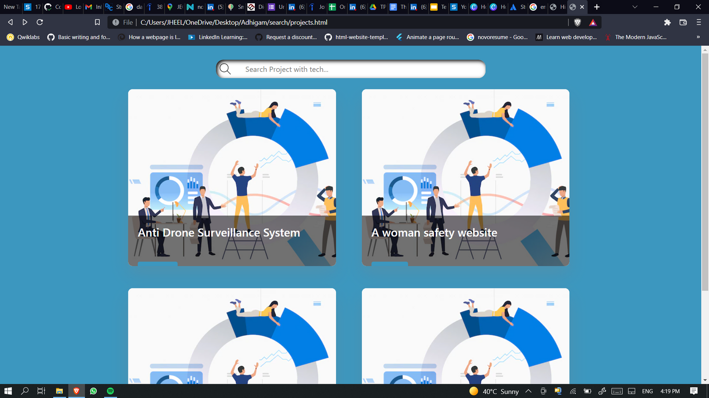


HOME PAGE
SEARCH

Slide 8
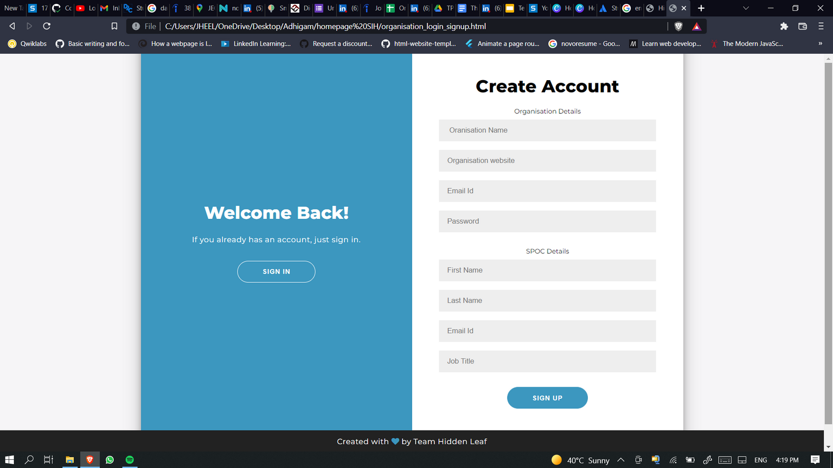

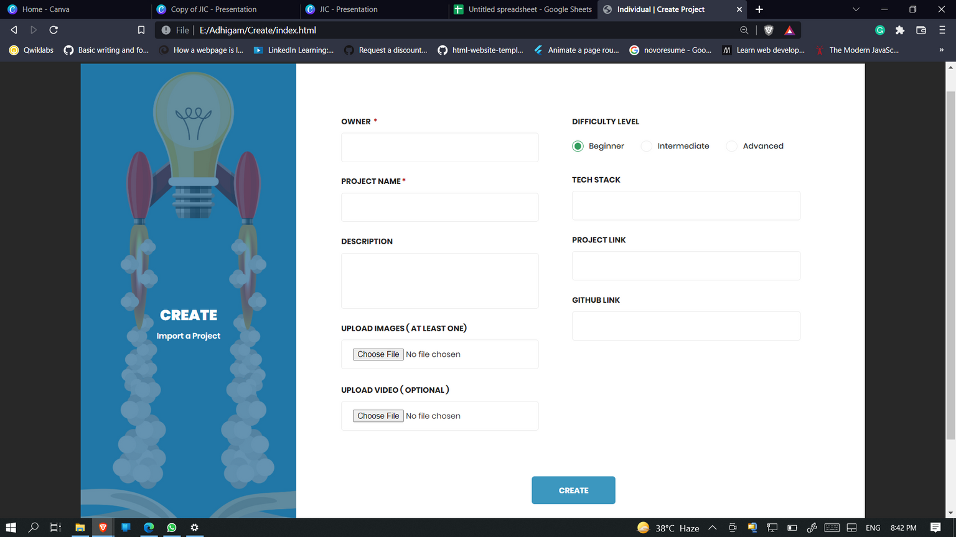
LOGIN / SIGN UP
PROJECT SUBMISSION!

Slide 9
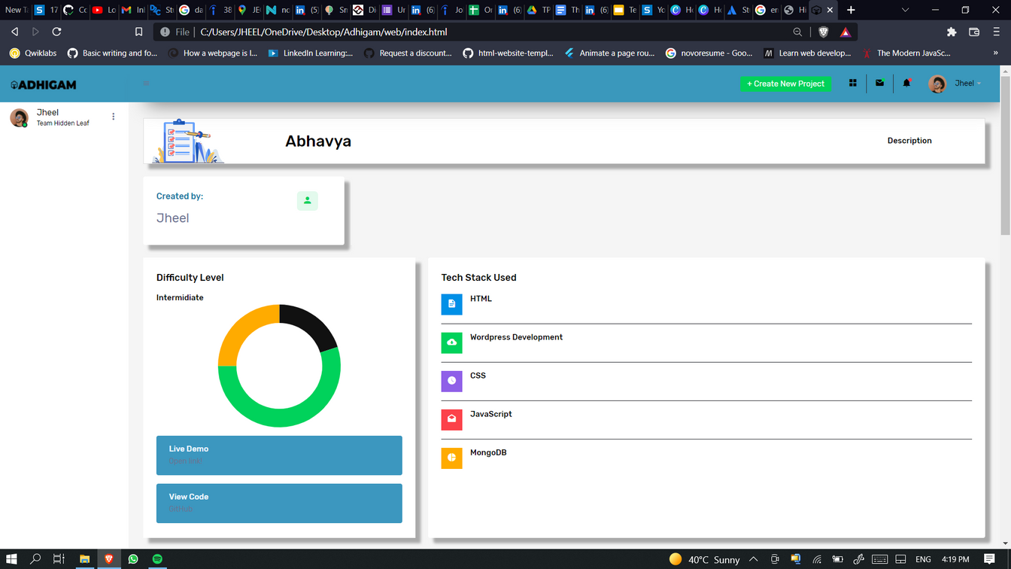
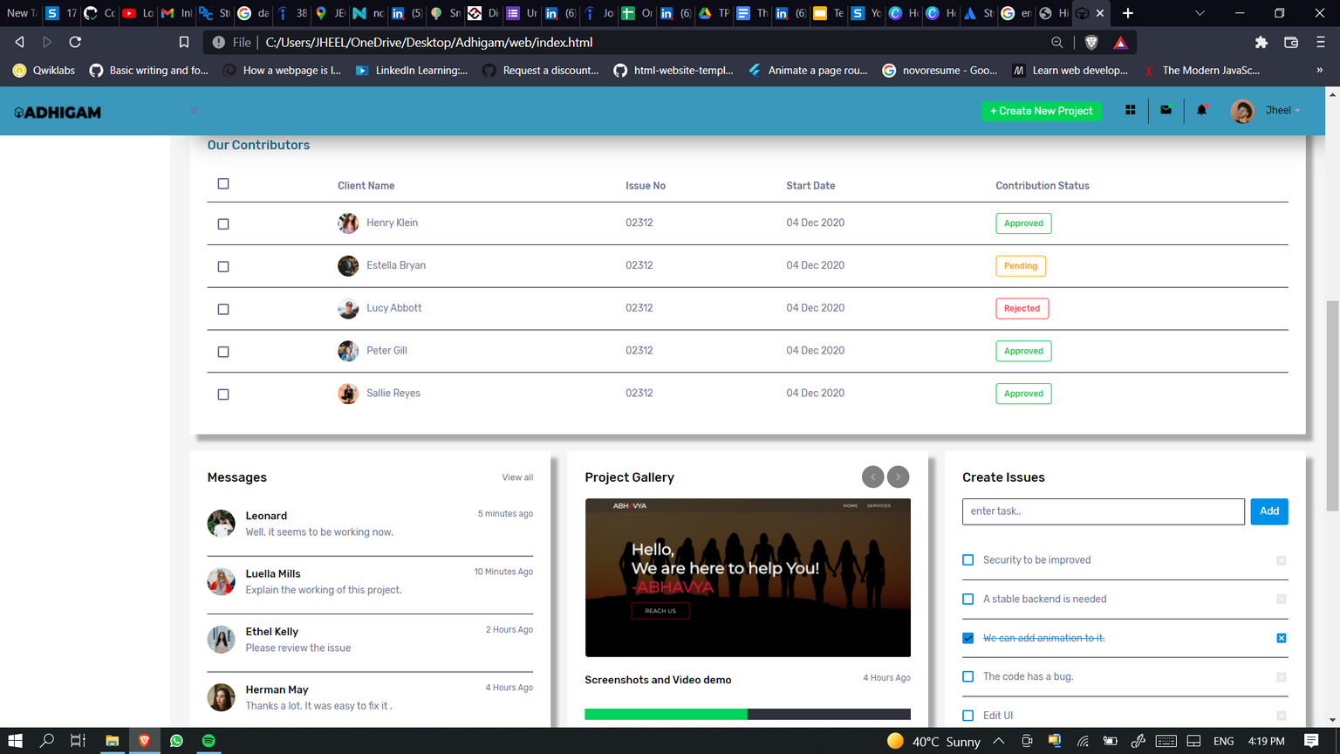
DASHBOARD
CONTRIBUTORS, ISSUES CREATED, GLOBAL CHAT AND GALLERY

Slide 10





Register yourself.
University,
individual
Upload your Project details!
Code plagiarism will be check!
Project details will be showcase in
realtime Dashboard
PRODUCT FLOW
Search Projects through various filters e.g tech stack
Interact with other contributors via global chat function
Take part in various programmes and initiatives
Grow Yourself!

Slide 11




MARKET SIZE
Organizations
20%
COLLEGES
Colleges
40%
UNIVERSITIES
Individual
10%
INDIVIDUAL
ORGANISATIONS
Universities
30%

Slide 12
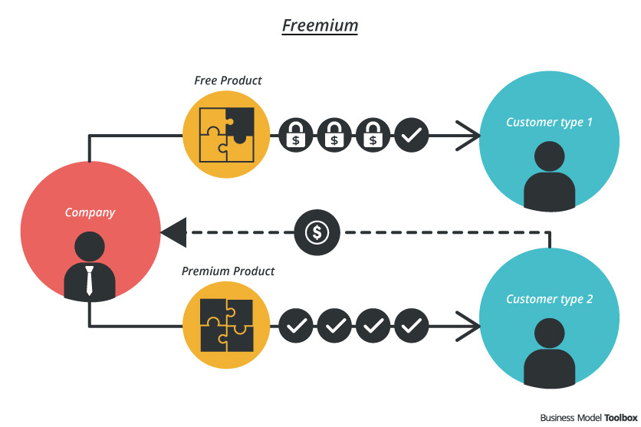

REVENUE MODEL

Slide 13
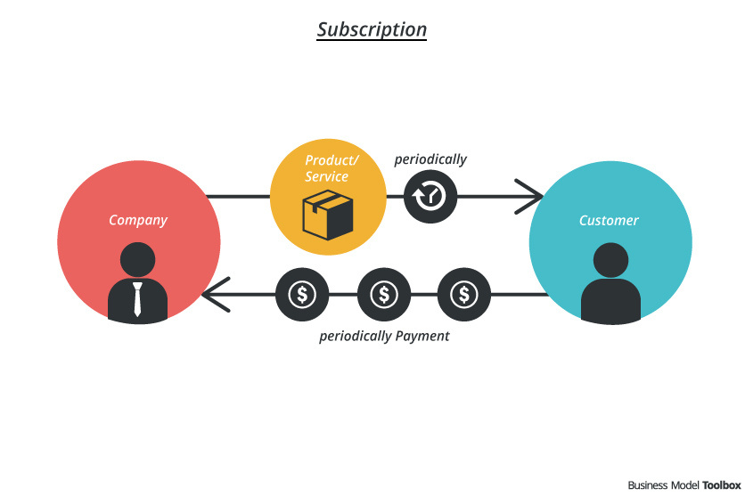
REVENUE MODEL

Slide 14
50%
Development and SEO
Future Needs
20%
FUND UTILIZATION
30%
For marketing
Development
50%
Future needs and emergency requirements
Marketing
30%
20%

Slide 15



HARDWARE
OPEN SOURCE
COMMUNITY
ENGAGEMENT
PROJECT
DASHBOARD
PROJECT
MONITORING
PLAGIARISM
GITHUB
COMPETITORS
PRODUCT
HUNT
ADHIGAM

Slide 16
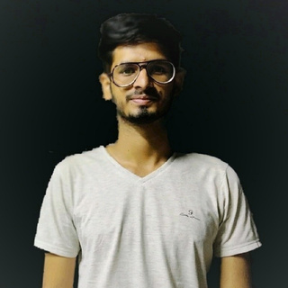
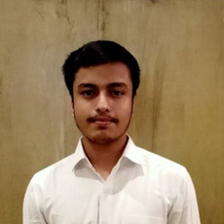
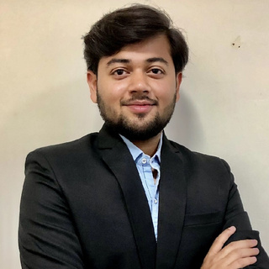
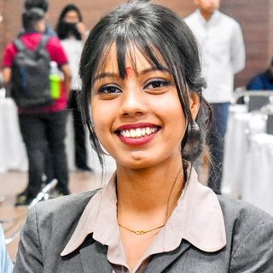
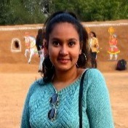

Our Best
Team Work
Aditya Shekhawat
Harshit Sharma
Kushagra Gupta
2nd Year
2nd Year
2nd Year
Vaishnavi Vaishnav
Jheel Soni
Piyush Lakheda
2nd Year
2nd Year
2nd Year

Slide 17
Thank
You!

